Slide 1
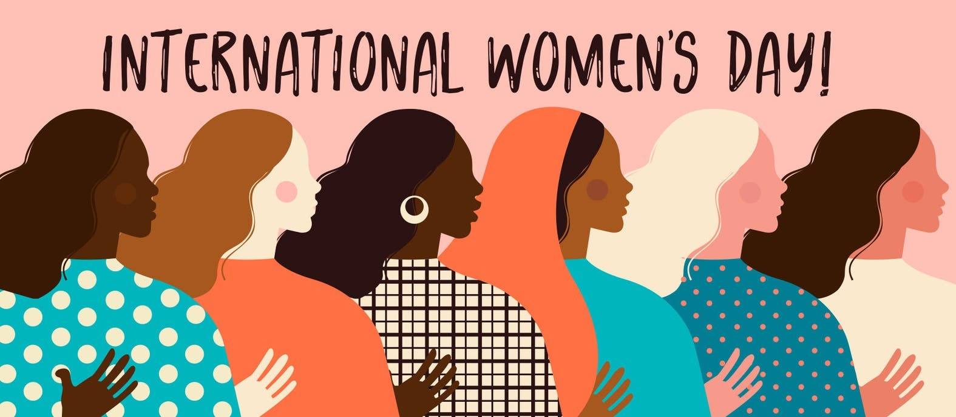

Slide 2
This year the theme is #EmbraceEquity
What does equity mean?

Slide 3
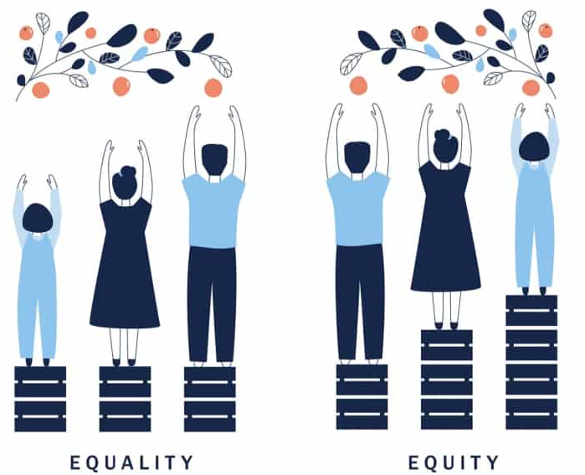

Slide 5
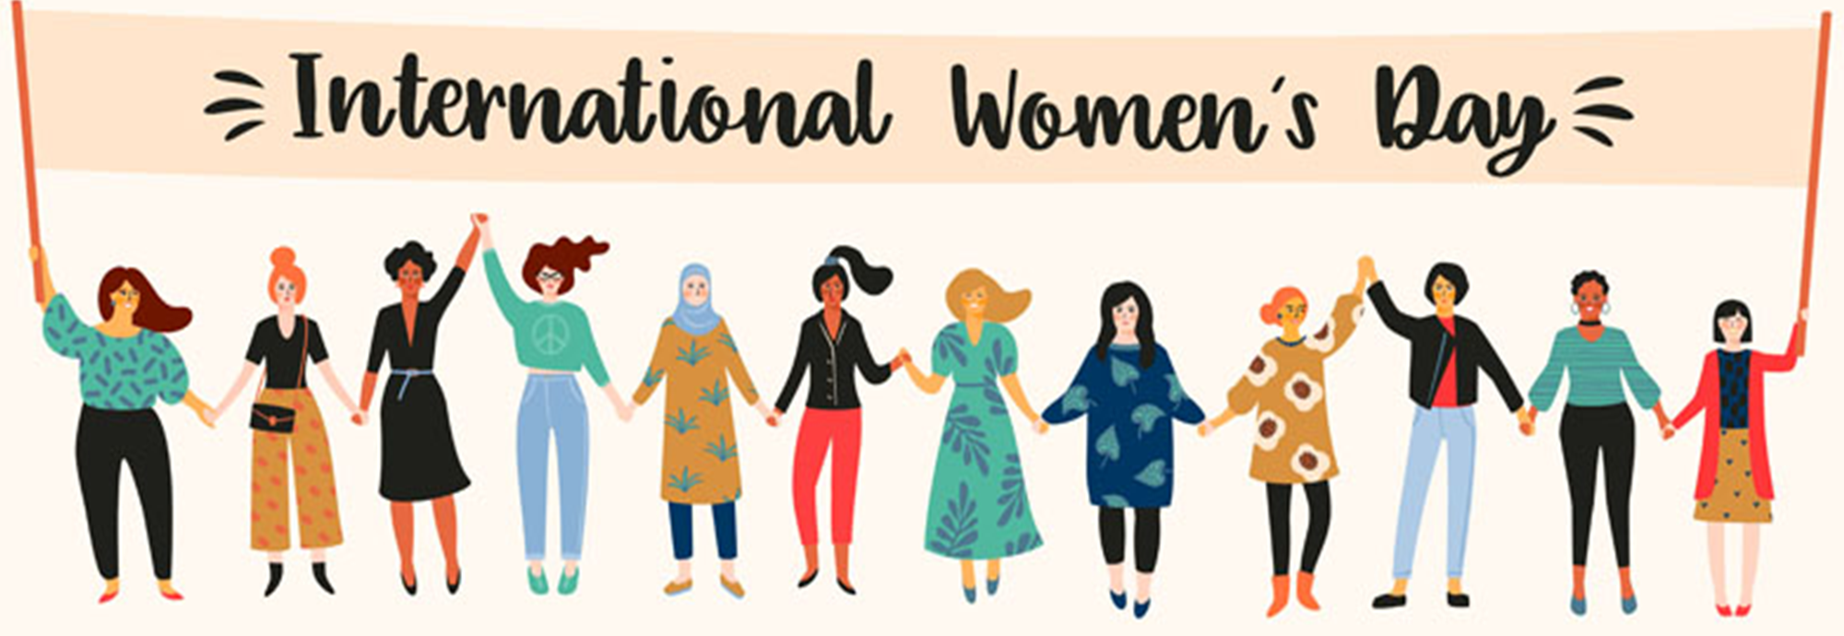
Discuss: Which women do you want to celebrate this International Women’s Day? What did they/ do they do?

Slide 6
https://www.youtube.com/watch?v=0PzWnljCpL0

