Slide 1
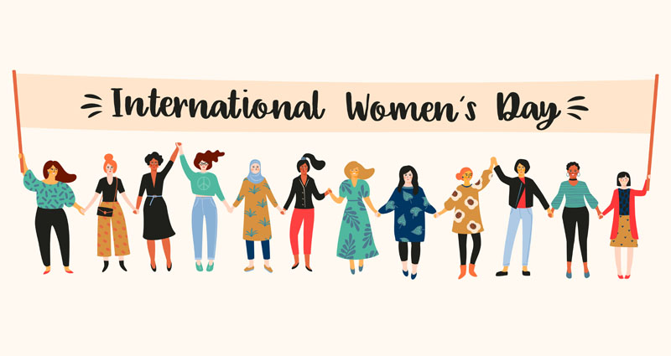
From great medieval queens to nurses in the First World War, the role of women throughout English history has often been overlooked.
Women in history!

Slide 2
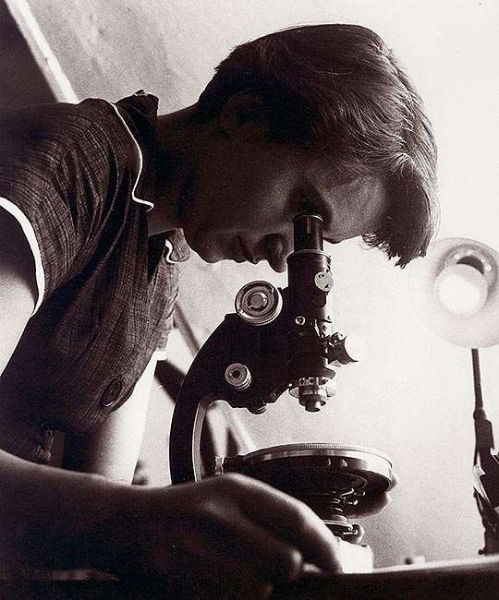
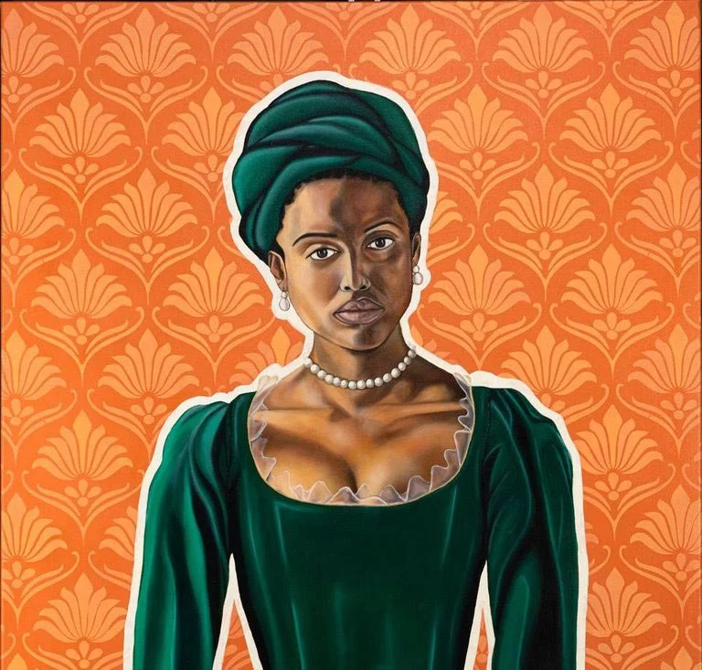
Scan the QR codes below to discover more about women in history!
FRANKLIN, ROSALIND
DIDO ELIZABETH BELLE
ELEANOR OF AQUITAINE

